Slide 1

Sample, Scrutinize and Scale: Effective Inference-Time Search by Scaling Verification
Group members
Javeria Shahid 21L-7694
Wara Imran 21L-6244
Abdur Rehman Haroon 21L-5691
Abdul Basit 21L-6259

Slide 2
Overview
Brief introduction of the authors
The motivation behind the paper
Problem elaboration
S³ Sample, Scrutinize, Scale
Methodology
Analysis of S³
Comparison with other methods
Example
Conclusion & key takeaways

Slide 3
The authors
Researchers and Scientist at Google Research
Eric Zhao
language models, reasoning, and scalable inference.
Pranjal Awasthi
Machine Learning Theory, Efficient Algorithms, and Learning at Scale.
Sreenivas Gollapudi
contributed extensively to making AI more efficient and scalable.
Common theme: “Improving AI reasoning”
Notes:
Improving AI reasoning

Slide 4
1. Motivation
Sampling-based search as a fundamental paradigm
Understand what governs scaling test trends
Evaluating limits of a minimalist approach
Introduce benchmarks to address self-verification deficits
The importance of test-time compute scaling
Balancing quality and efficiency
https://doi.org/10.48550/arXiv.2502.01839
Notes:
At inference time you can make a model much smarter simply by generating lots of answers and picking the best one without the need for training from scratch

Slide 5
1.2 Goals
Simplicity
Scalability
Parallelism

Slide 6
2. Problem Statement
For AI tasks of
Search
Retrieval
Summarization
Smart verification, not exhaustive
Combatting full verification and no (or very little) verification
what test-time scaling trends emerge as we scale both the number of sampled responses and verification capabilities?

Slide 7
3. Introduction to S³
Select the best candidate response at inference time
Sample
A small subset of candidates
Scrutinize
Self-verification
Scale
Analyze the effect of increasing compute and parallelism

Slide 8
4. Methodology—Algorithm
Generate responses
Given a prompt
Verify responses
verification scores assigned to each candidate
Scaling study
Accuracy across different values of responses sampled and verification scores
Handling ambiguity
Top 5%
Self-verify the best responses
Localizes small errors and differences

Slide 9
4.2. Technical Details
Using Gemini v1.5-Pro & FLASH and Verification@kinf
Sampling setup
Responses per question = 200
Temperature = 1.5
Verification
50 verification queries per response candidate
Highest verification scores
To choose from close verification scores—Tie Breaker
Pick top 5% scoring responses
Run 100 pairwise comparison
Notes:
Temperature = 1.5: Use moderately high randomness for diversity.

Slide 10
4.3. How it works with Gemini
Input
User prompt or question
Sample
Gemini Pro
Scrutinize
Gemini or Flash
Select
Candidates with highest verification scores
Tie-breaker
Run 100 pairwise comparison
Output
Return best verified answers

Slide 11
4.4. Impact of Number of Inference Attempts
Notes:
ine graph depicting the accuracy rates of the Gemini v1.5 Pro model using samplingbased
search as the number of candidate responses generated is scaled upwards. The number of
verification attempts is fixed at 50 for all plots. The depicted accuracies are obtained without tiebreaking
and may be lower than reported elsewhere. Verification@k improves with k even when
Consistency@k stagnates on AIME and LiveBench Reasoning.

Slide 12
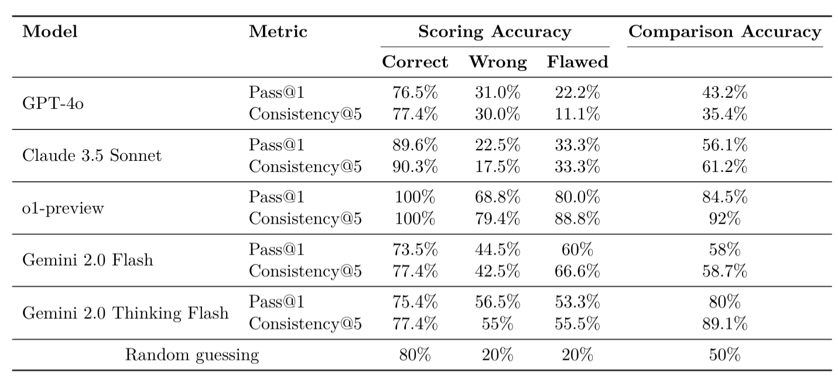
5. Comparison
Notes:
GPT-4oandClaude3.5Sonnetonly performmarginallybetterthanrandomguessingacrossall tasks. o1-Previewperformsbetter,but still failstoidentify20-30%ofwrongresponses

Slide 13
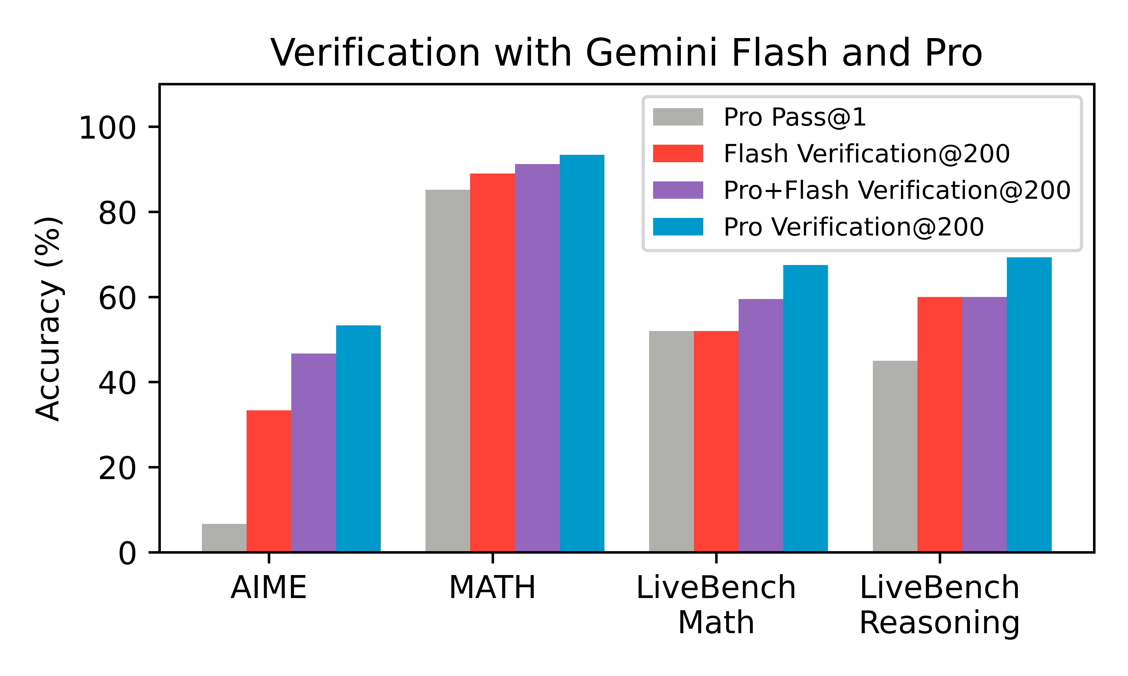
5.2 Visualized comparison

Slide 14
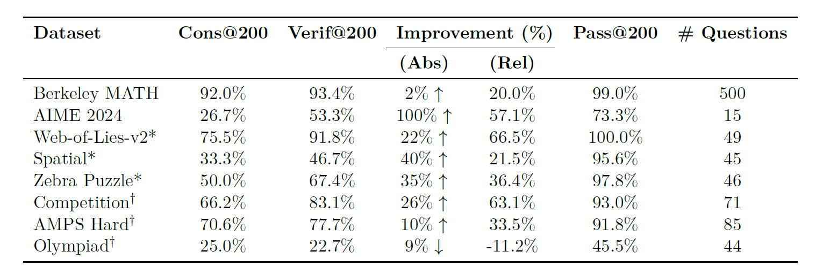
6. Performance

Slide 15
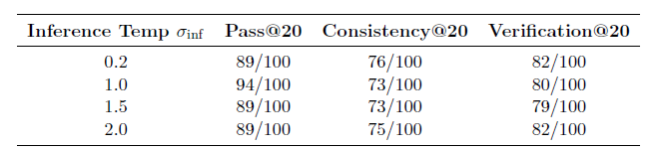
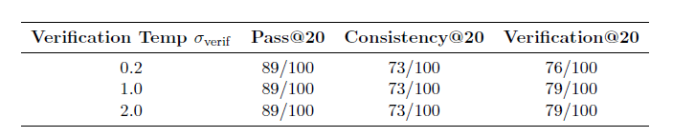
6.2. Temperature’s impact
Notes:
The temperature used for verification attempts is fixed at σverif = 1.0. Inference
temperature does not significantly affect downstream performance.
The temperature used for generating responses is fixed at σinf = 1.5. Verification
temperature does not significantly affect downstream performance

Slide 16
Why S³
Saves massive compute and time.
Still achieves near-optimal output quality.
Works across many different AI tasks.

Slide 17
Recap
Generate many answers
Make the model question each answer multiple times
Select the highest scoring answer
To narrow down from similar scores, directly compare each answer

Slide 18
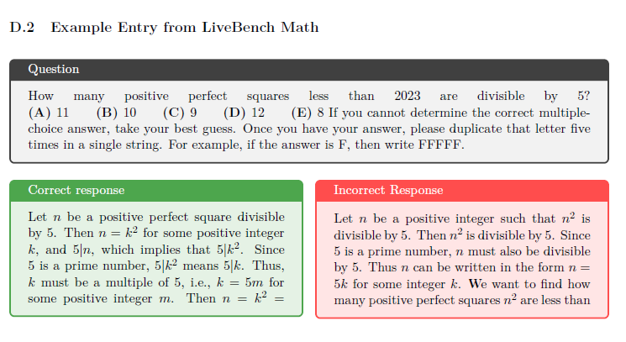
Test Case Example

Slide 19
7. Conclusion & Key Takeaways
Sampling-based search scales efficiently with simple, parallel implementations.
Implicit scaling and self-verification at test-time boost performance.
It sets a strong baseline for evaluating model inference capabilities.
Future improvements should focus on systematic, agentic, and inference-aware search methods.

